Slide 1
C&B POLICY

Slide 2
C&B
Compensation
Base salary
Allowance
Benefit
Social insurance
Bonus
Housing fund
Supplemental medical insurance
Others

Slide 3
C&B Objective & Principle
C&B objective
The company strives to maintain competitive C&B in order to attract, motivate and retain talented employees
C&B principle
Ascertaining compensation levels based on
Individual performance
Market survey results
Business conditions
Market competitive benefit
Employees shall keep salary information confidential

Slide 4
Base Salary Determination & Adjustment
Starting salary is determined according to
Prevailing standards in the labor market
Individual capability
Company’s salary system
Employees’ salary adjustment is based on
Individual performance-High performance high pay
Regular market salary surveys results
Business Status

Slide 5
Compensation
Base Salary
Allowance
Bonus

Slide 6
Base Salary
Base salary is paid on a monthly basis, and calculated from the first day until the last day each month
Salary is paid on the 7th of each month
Non paid leave will deducted from your base salary
Allowance
Lunch: RMB8/day
Shuttle bus: RMB 350/month
Annual bonus
Annual discretionary bonus is equal to one month’s base upon satisfactory achievement of assigned business objectives and the overall success of the business
Pro-rated based on average monthly base salary and the number of working days employed until December 31
Utilization bonus
Applies to all billable personnel
Calculated based on individual billable hours and travel hours
You can find the detail policy here:
Sharepoint > GDC > HR > HR Policy > Bonus
Based on average salary for current year
Pro-rated for service months through December 31
Notes:
Vacation, unpaid leave or time in the US shuttle bus and lunch are not paid

Slide 7
Benefit
Social Insurance
Housing Fund
Vacation
Others
Supplemental Insurance

Slide 8
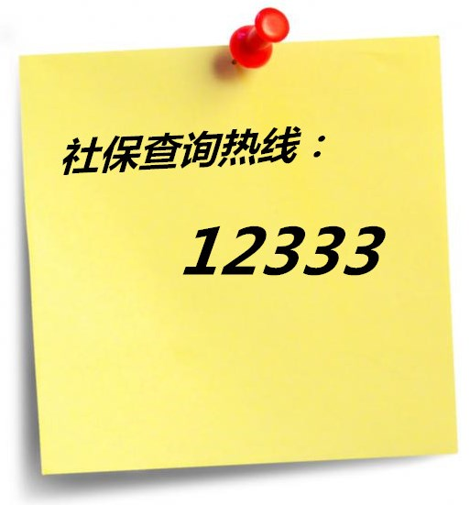
社保缴交
社保缴交比例及基数
公司缴交：28.6%
个人缴交：10.5% + 重大疾病补助3元/人 + 困难互助救济1元/人
缴交基数：新员工为基本工资；次年起为员工上一年度月均工资
缴交基数封顶及保底：每年6月份由社保局公布
社保
医疗保险
公司：11.5%
个人：2% + 4元
养老保险
公司：14%
个人：8%
失业保险
公司：1.5%
个人：0.5%
生育保险1.2%
（仅公司缴交）
工伤保险0.4%
（仅公司缴交）
Notes:
开通个人网上业务可持本人身份证至社保局柜台办理。

Slide 9

公积金缴交
公积金缴交比例及基数
公司缴交12%
个人缴交12%
缴交基数：新员工为基本工资；次年起为员工上一年度月均工资
缴交基数封顶及保底：每年7月份由公积金中心公布
公积金网上查询:
http://web.zjgjj.com:7001/szhfsnet/
- 初次登录需注册
- 注册所需个人客户号可在工资单中查询
个人客户号应为12位，如工资单中显示号码不足12位，请在前面加0补足
省公积金中心热线：12329
Notes:
公积金下限为杭州市区最低月工资标准，1470为2013年1月起用的数据，至今尚未调整。

Slide 10
补充医疗保险
Accidental Insurance 意外伤害保险金
Accidental/work related injury disability 意外、工伤残疾
Work related injury/occupation disease death 工伤、职业病身故
Accidental Death 意外身故
Disease Death 疾病身故
Supplementary Hospitalization 补充住院医疗保险金
Clinic and emergency clinic 门急诊医疗
You can find details at: Sharepoint> GDC > HR > HR knowledge and information sharing > Supplemental medical insurance

Slide 11
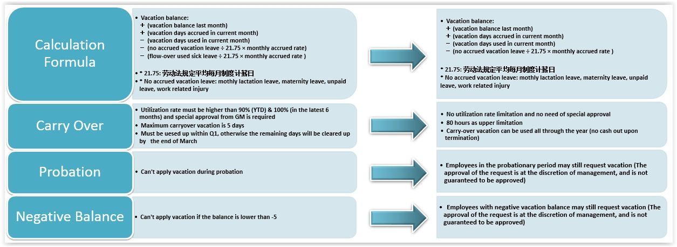
年休假政策
Notes:
平均每月制度计薪日，具体计算方法为：
年记薪总天数：365天－104天（为一年52周的双休日）=261天
平均月记薪日：261天÷12月=21.75天/月

Slide 12
Others
Employee Marriage/Child Birth
Gift card costs RMB 500 for marriage
Gift card costs RMB 200 for baby birth
Annual physical check up
Organizational Team building activities
Outing activities
Annual party
5&10 year anniversary reward
Reward employee who be with company for 5&10 years

Slide 13
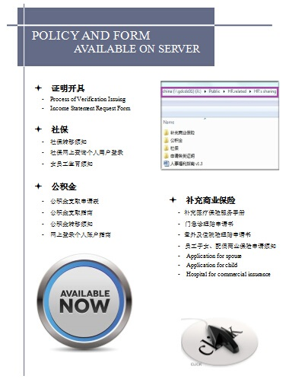
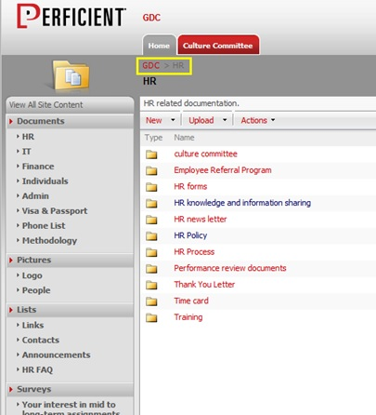
Where Can I Find the Policy?

Slide 14
Thank You !

